Slide 1
Reconstruction Standard for Neuron Morphology
Four levels of readiness for neuron reconstruction are defined.
Level-0: Location of Soma, Dendrite area and Axon Terminal site of Long projection;
Level-1: Dendrite, Major branches of Axon and Long projection axon without detail cluster;
Level-2: Level-1 and clusters of axon in detail;
Level-3 in future: Level-2 and Spine information (distribution and length).

Slide 2
Detailed Standard for Level-0
Soma： Location of the neuron (Allen Brain Atlas).
Dendrite: The Scope of Dendritic tree.
Axon: Long projection terminal site.
Workflow for Level-0
Autotrace can make Level-0 done first.
Clean the extra signal near the neuron by annotator if necessary.
Analyze the scope of dendrite and check the location and Axon terminal site.

Slide 3
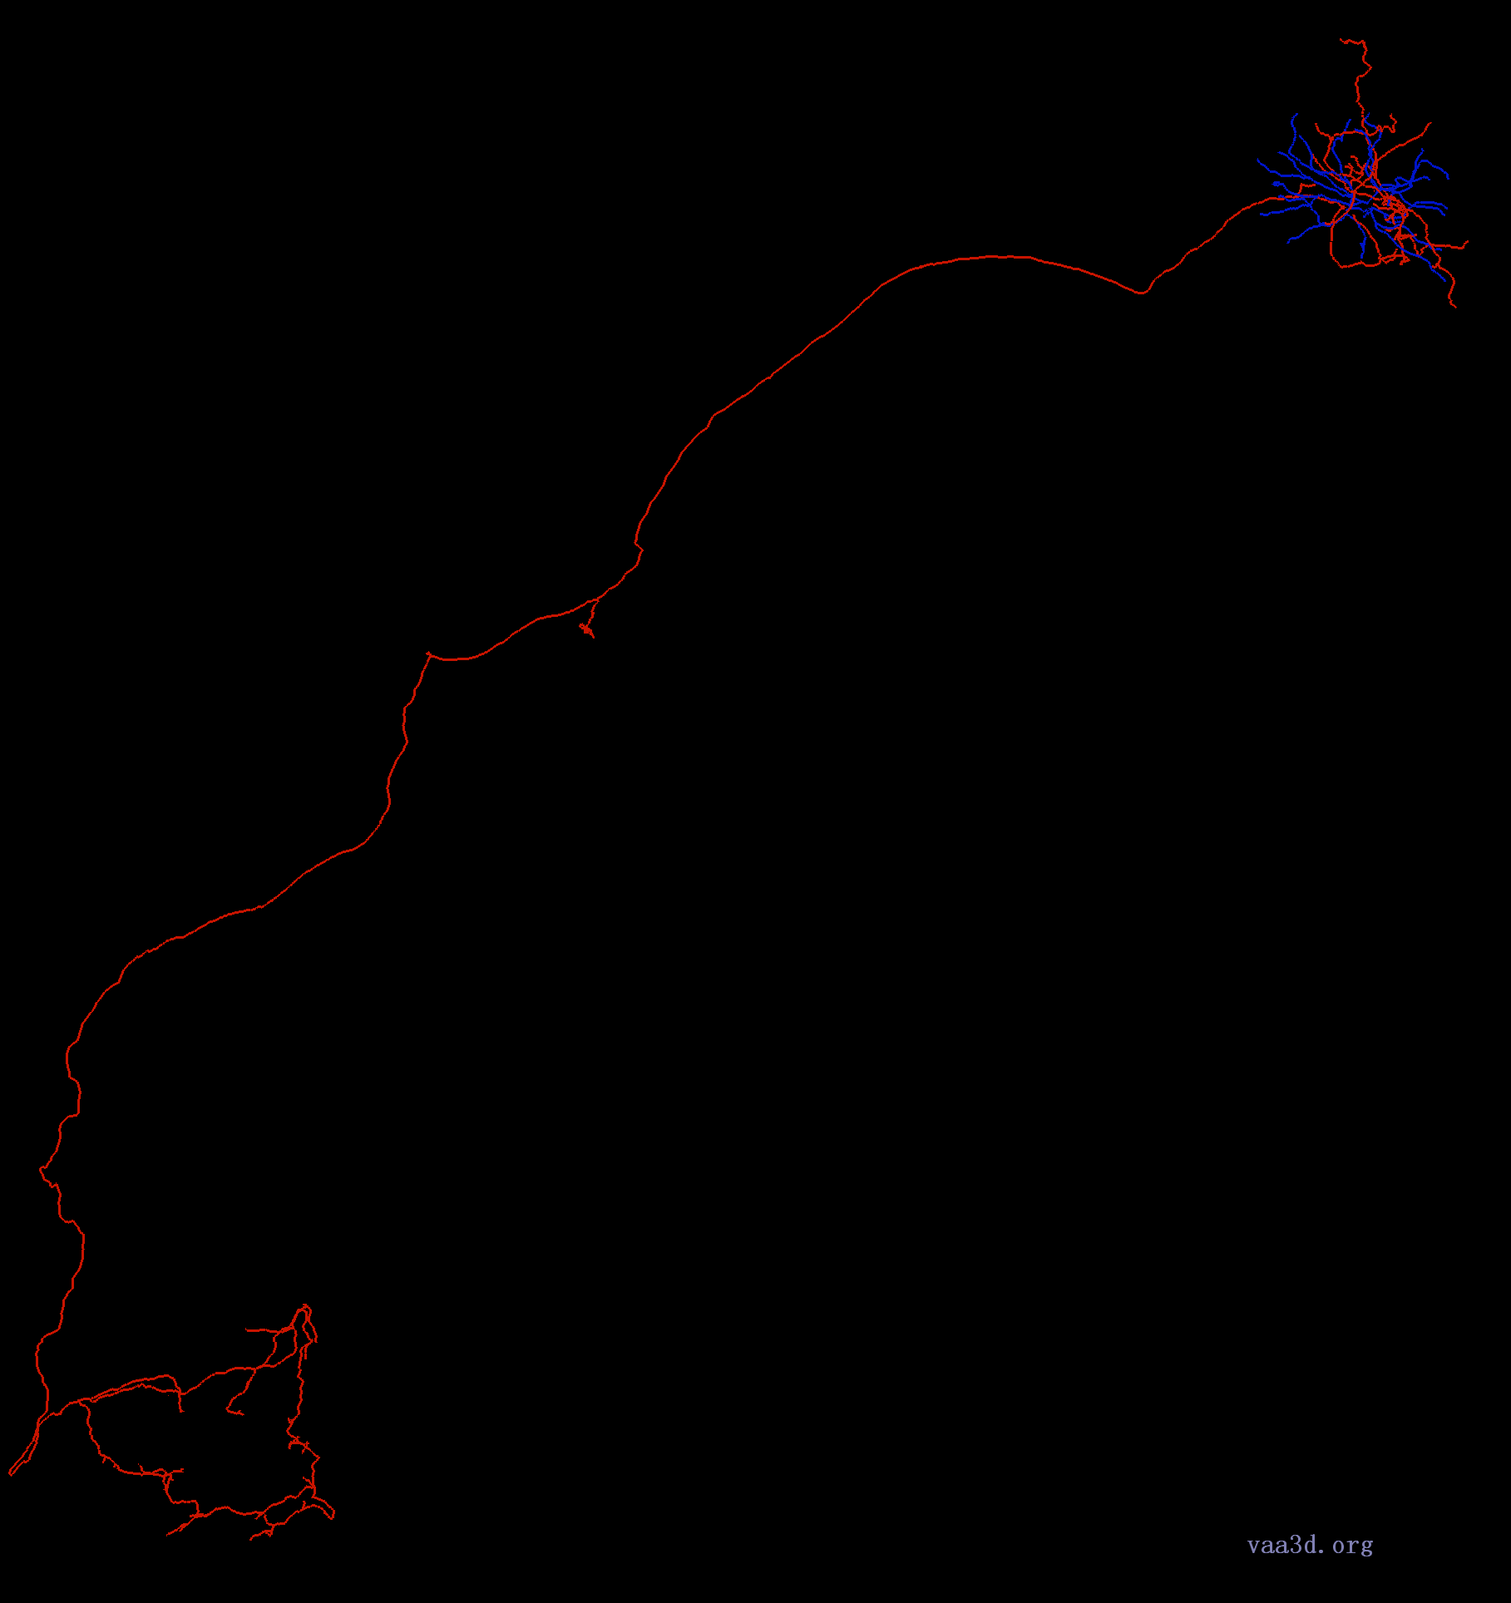
Detailed Standard for Level-1
Dendrites:
The complete distribution of dendrites is traced (100% finished).
Axons:
Local axon branches (nearby its own soma area) are completely traced.
All the long projections are traced. These projections reach areas registered in Allen Atlas.
In each registered area, multiple branches which form a cluster are traced. However, axons in clusters might be incomplete.
No loop is allowed
Vaa3D will enable automatic loop detection function!
Dendrite-Blue
Axon-Red
Dendrite
Local Axon
Projections
Incomplete Clusters

Slide 4
Tracing Workflow of Level-1
First annotator traces the neuron, and adds markers at unfinished locations. （File:Level_1A）
Second annotator checks the tracing result, and makes necessary modifications. （File:Level_1B）
Some automatic algorithms could help to check the result (e.g. automatically detect missing branch point, false connection, etc..)
First annotator confirms the modifications from second annotator, and do reconstruction again. （File:Level_1C）
Third annotator checks the tracing result and make modifications
(all above should happen at Nanjing) （File:Level_1D）
Gatekeeper checks the neurons randomly (at least 30% should be rechecked), and release the data.

Slide 5
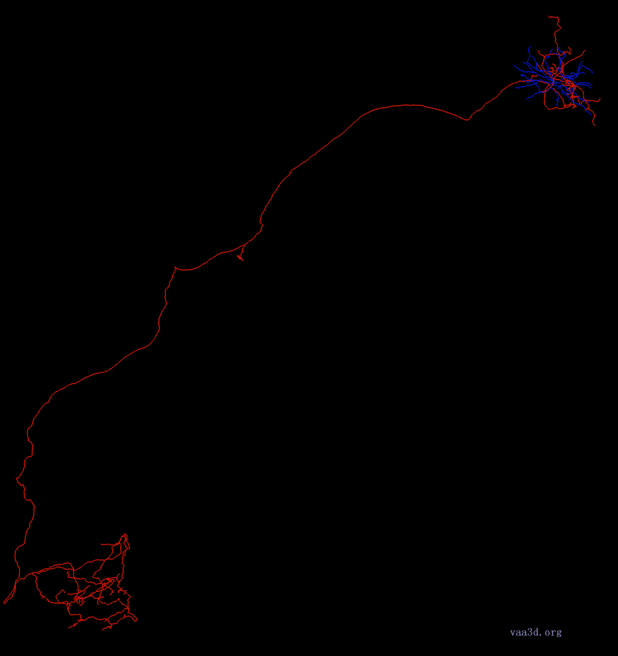
Detailed Standard for Level-2
All the level-1 structures are traced.
All axons signals in clusters are traced.
No loop is allowed
Dendrite-Blue
Axon-Red
Dendrite
Local Axon
Projections
Clusters

Slide 6
Tracing Workflow of Level-2
First annotator traces the neuron. (based on traced neuron)
（File:Level_2A）
A set of markers are automatically generated and placed on the below positions: （File:Level_2B）
Tips (N1 markers) (auto)
Branch points (N2 markers) (auto)
Potentially missed branch points (N3 markers) (need algorithm dev)
Overlapping neurites (N4 markers) (need algorithm dev)
Markers manually set by first annotator for uncertain locations (N5 markers)
Second annotator checks 30% markers for each category.
（File:Level_2C）
If all these regions are correctly traced, the neuron is considered completely traced.
Otherwise, if there are errors in certain category, second annotator makes necessary modifications, and checks extra 30% markers for that category.

Slide 7
Reconstruction Work Flow
Neuron ID Assigned
Level_2 ID Assigned
YES
NO
YES
NO
Level_1A
Check again
Level_2A
Check again
YES
NO
YES
NO
Level_1B
Redo
Level_2B
Redo
YES
NO
YES
NO
Level_1C
Back to Level_1A annotator
Level_2C
Back to Level_2A annotator
YES
NO
Level_1D
Back to Level_1B annotator
Move to Finished Neurons
Move to Level_2 Step
Rules for Tracing colors:
Dendrite: .3-Blue
Axon: 2-Red.
Marker for branch points: Red for unfinished branch, Blue for finished branch, Yellow for unsure status. DO NOT DELETE MARKERS!
After check:
Dendrite: 5-Light blue for adding, 0-White for false(lines should be deleted)
Axon: 7-Green for adding, 0-White for false (lines should be deleted)

Slide 8
Detailed Standard for Level-3
All Level-2 structures are traced.
Spines of Dendrites are labeled.
Numbers (D1 markers) (auto?)
Length threshold should be analyzed, Markers for spines over threshold (D2 markers).

Slide 9
Rules for Tracing colors
Dendrite: .3-Blue
Axon: 2-Red.
Marker for branch points: Red for unfinished branch, Blue for finished branch, Yellow for unsure status. DO NOT DELETE MARKERS!
After check:
Dendrite: 5-Light blue for adding, 0-White for false(lines should be deleted)
Axon: 7-Green for adding, 0-White for false (lines should be deleted)

